Slide 1

Fire Alarm System Using Arduino
TEAM NAME : MISSION POSSIBLE
LET'S SEE...

Slide 2

Overview
HARDWARE COMPONENTS WITH CIRCUIT DIAGRAM
01
PROBLEM STATEMENT
04
01
PROPOSED SOLUTION
CODING
05
03
METHODOLOGY
06
CONCLUSION

Slide 3

Problem Statement
Fire accidents can be hazardous for both people and property.
Traditional smoke detection systems are not always reliable and require manual intervention.

Slide 4
Proposed Solution
The Smoke Detection System using Arduino is a reliable and cost-effective solution to detect smoke.
The system works by using sensors to detect smoke and triggering an alarm to alert people in the vicinity.

Slide 5

Methodology
The system is built using an Arduino Uno board, smoke sensor module, buzzer, and LED.
The hardware components are connected according to the circuit diagram, and the code is uploaded to the Arduino Uno board.

Slide 6

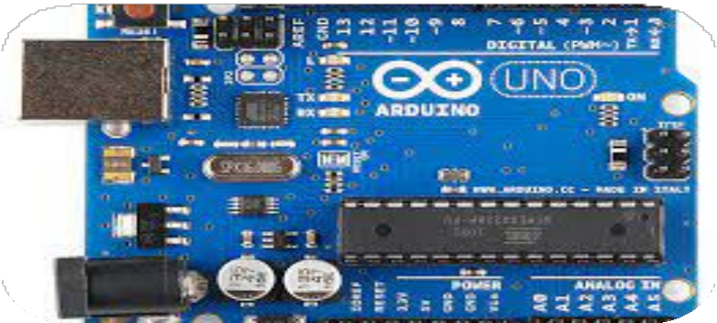


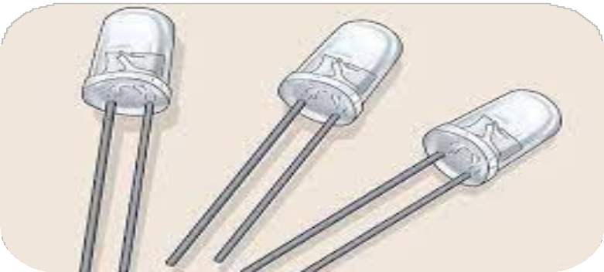

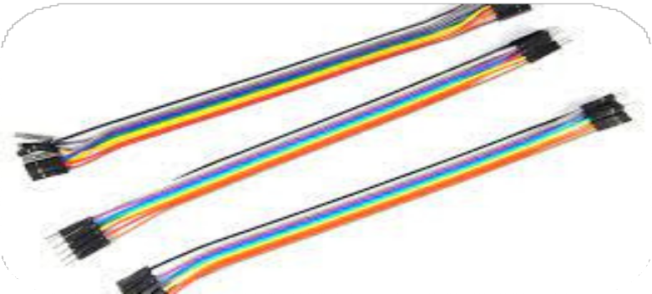
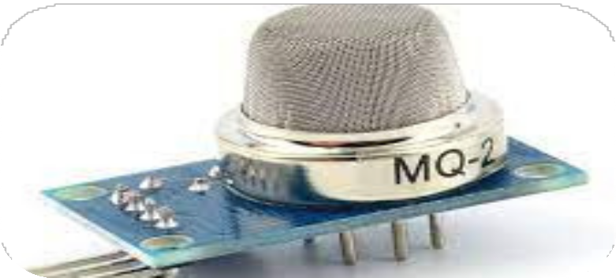
1.Arduino Board
Hardware Components
2.Bread Board 3.Resistor
4.LED light
5.Piezo Buzzer 6.Jumpercables
7.Smoke Sensor

Slide 7
Circuit Diagram

Slide 8
Coding
#include <LiquidCrystal.h> LiquidCrystal lcd(5,6,8,9,10,11); int redled=3;
int greenled=2; int buzzer=4; int sensor= A0;
int sensorThresh=400; void setup()
{
pinMode(redled,OUTPUT); pinMode(greenled,OUTPUT); pinMode(buzzer,OUTPUT); pinMode(sensor,INPUT); Serial.begin(9600); lcd.begin(16,2);
}
void loop()
{
int analogValue= analogRead(sensor); Serial.print(analogValue); if(analogValue>sensorThresh)
{
digitalWrite(redled,HIGH);

Slide 9
Coding
digitalWrite(greenled,LOW); tone(buzzer,1000,10000); lcd.clear(); lcd.setCursor(0,1); lcd.print("ALERT"); delay(1000);
lcd.clear(); lcd.setCursor(0,1); lcd.print("EVACUATE"); delay(1000);
}
else{ digitalWrite(greenled,HIGH); digitalWrite(redled,LOW); noTone(buzzer);
lcd.clear(); lcd.setCursor(0,0); lcd.print("SAFE"); delay(1000); lcd.clear(); lcd.setCursor(0,1); lcd.print("ALL CLEAR"); delay(1000);
} }

Slide 10

Conclusion
The Smoke Detection System using Arduino is a reliable and cost-effective solution to detect smoke and prevent fire accidents.
Using an Arduino-based system offers several advantages, including flexibility, low cost, and ease of programming.

Slide 11
Thank You !
PRESENTED BY
LOHITH M R PRANAV G NIRMALKUMAR C M ILAMPARITHI E NAVIN KUMAR P

